Slide 1
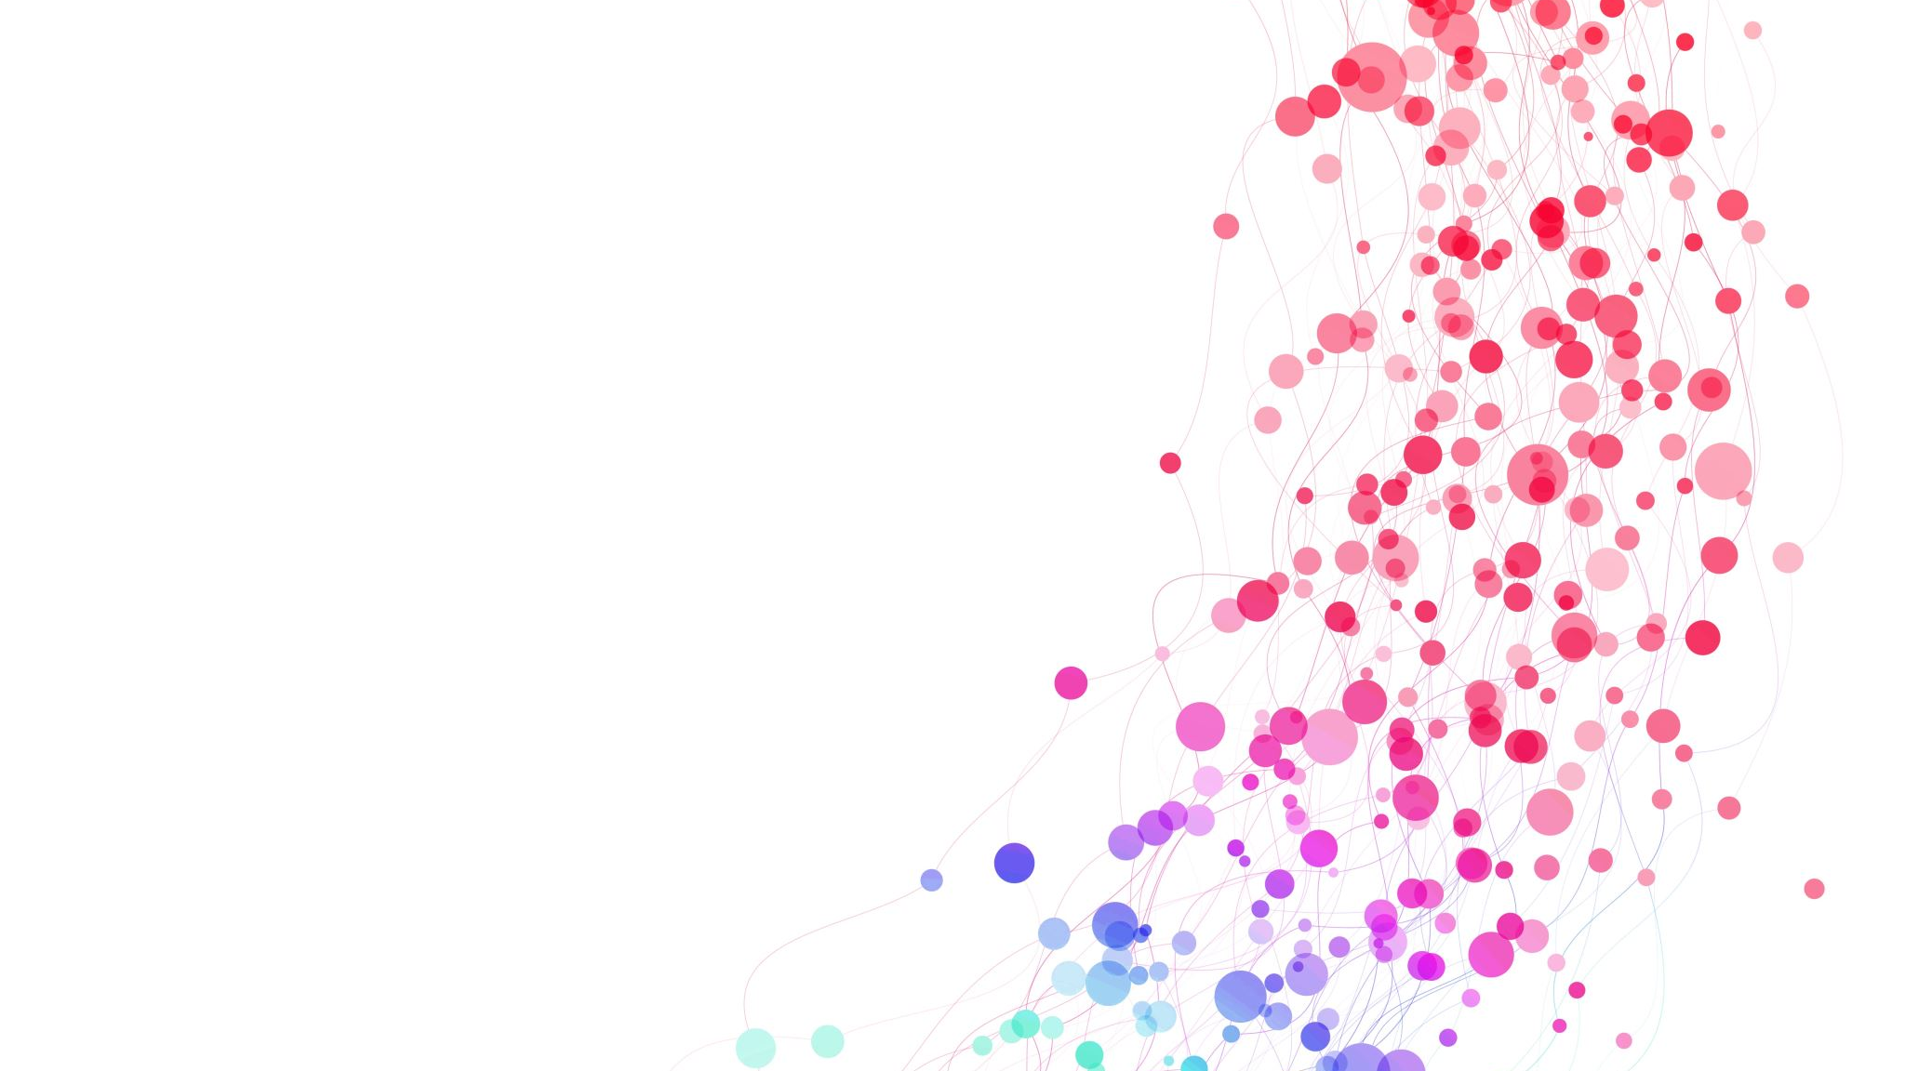
Fatal Police Shootings
Summary of Findings from Exploratory Data Analysis
By Noah Baugh

Slide 2
The Details:
Objective: To analyze patterns in shootings through exploring flee status, types of threats made to officers, frequency of mental illness in fleeing, and the clustering in states and cities
Approach: Conducted Exploratory Data Analysis (EDA) using Python in Google Colab. Using various plots, such as Bar Charts, Stacked Line Plots, Choropeth Map, and more.
Data Source: Flee status, Mental illness status, Types of threats, Location, Date.

Slide 3
The problems…
There is almost too much data, difficult to find selective patterns amongst the noise
There are no specific mental illnesses covered, just that they were mentally ill. Creating heavily inferred and unreliable connections
Finding a graph that worked how I wanted it to, showing the data clearly at a scale I wished to convey on.
Putting together and debugging a Choropeth Map

Slide 4
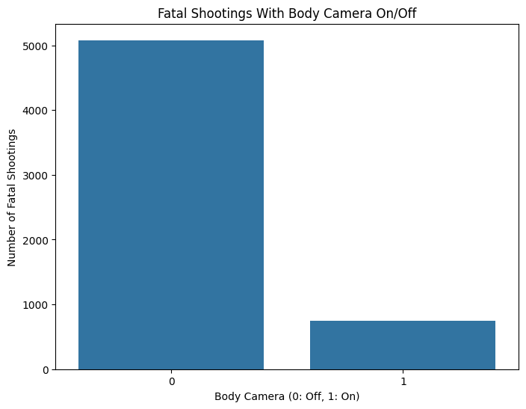

Slide 5
Key Findings:
Disparity in Fatally Shot Persons: Almost 8,000 police officers fatally shot in cases where body cameras were disabled is significantly higher than slightly over 1,500 cases in which body cameras were operational.
Impact of Body Cameras: Body cameras are associated with the potential for reduced fatal shootings, suggesting their contribution to increased accountability and influence in split-second judgment calls in critical incidents.

Slide 6
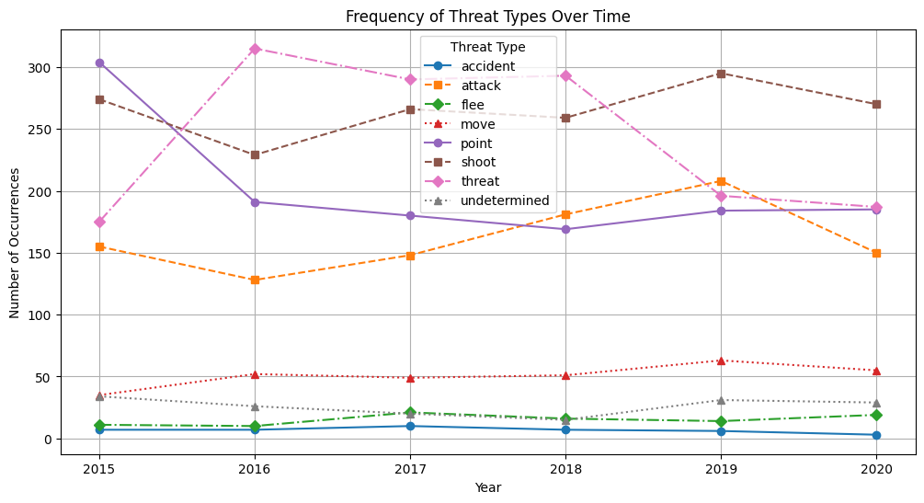

Slide 7
Key Findings:
Dominant Categories:
Threat incidents fluctuated but peaked in 2022 before they lowered down to almost nothing by 2024.
Spread incidents steadily increased consistently, reaching around 350 cases in 2021, and then flattened out through 2022–2023.
Moderate Trends:
Attack incidents showed an initial decline through 2015, followed by the gradual increase until 2019 and an instant decline, ending below 100 cases by 2023.
Point incidents exhibited a slightly increasing trend over the years, this means it is reflecting relative consistency in reporting.
Rare Threat Categories:
Categories like accident, flee, and undetermined remained almost fully flat, with very minor fluctuations, reflecting consistent but highly infrequent occurrences

Slide 8
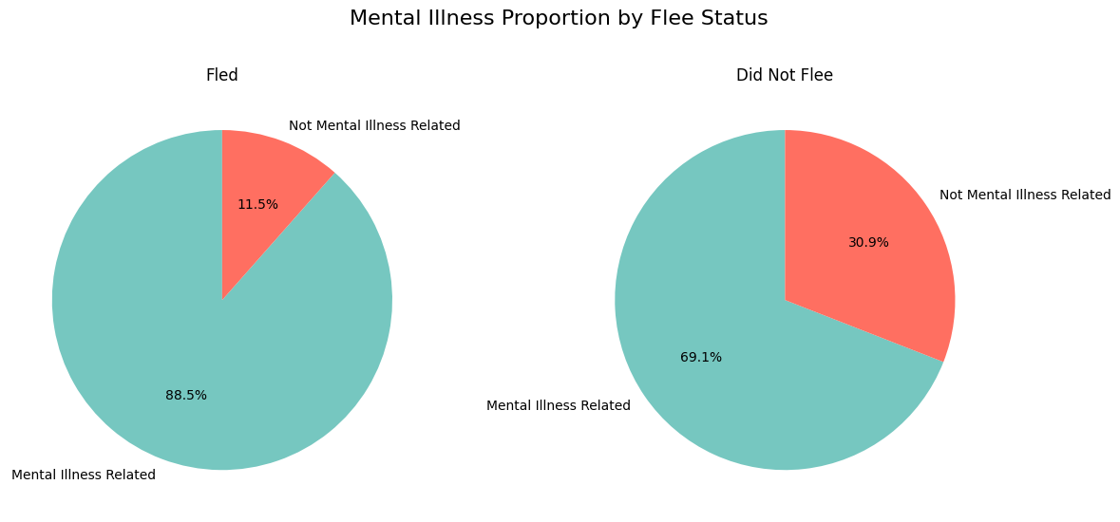

Slide 9
Key Findings
Fled:
88.5% of individuals who fled during police interactions were linked to mental illness.
11.5% of those who fled were not mental illness-related.
Did Not Flee :
69.1% of cases where individuals did not flee involved mental illness.
30.9% of non-fleeing cases were not related to mental illness.
Basic Insight:
Strong correlation between mental illness and the likelihood of fleeing during police interactions.
Even in non-fleeing incidents, mental illness remains a significant factor.

Slide 10
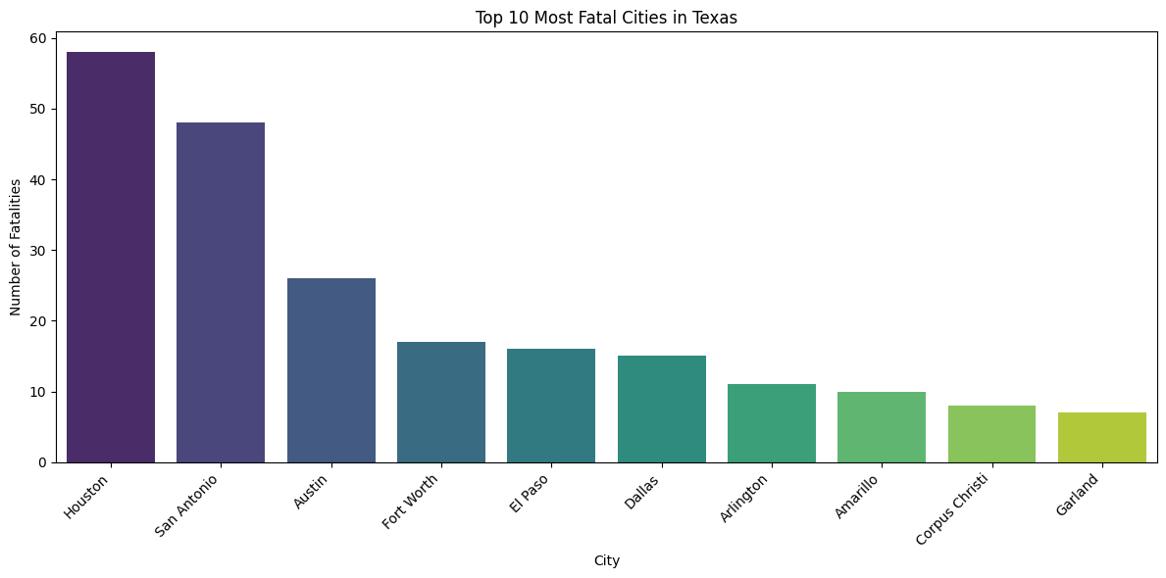
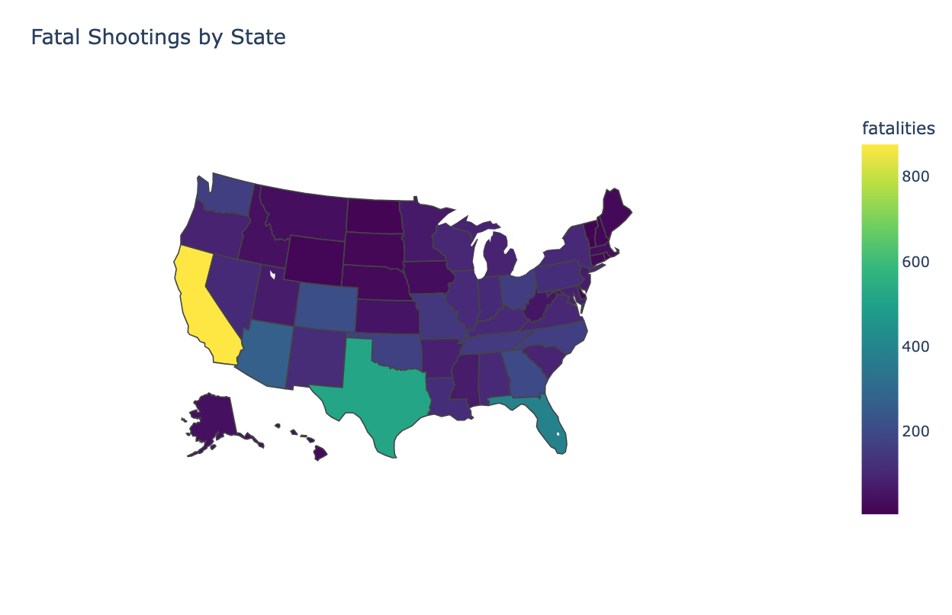

Slide 11
High Fatality States:
California and Texas are shown in yellow and green, as they are the states with the highest number of fatalities. With large populations, these states obviously would correlate with the higher absolute numbers of incidents.
A possibly higher rate of deaths in these states could also point towards urbanization and social inequalities and possibly reflect differences in firearm regulation from other regions..
Moderate Fatality States:
Moderate shooting allocators, such as Florida and Georgia and other southeastern states, shed more light on the generally high but moderate shooting record..
The clustering may reflect broader regional factors, such as the socioeconomic conditions, population density, and cultural perspectives towards firearms..
Low Fatality States:
States such as North Dakota and South Dakota in the Midwest and Vermont and New Hampshire in the Northeast have seen representation in an increasingly darker purple, a coloration that reflects a lower rate of fatalities..
The states that are generally less populous can also be said to have fewer urban contexts, with stricter gun laws..
Geographic Trends:
The failure in the larger states of the West and South shows a high shooting fatality count, while most of the states in the Midwest and Northeast have a lower shooting fatality count..
Said the disparity in the count may entail some factors reflecting the difference between the gun laws, the law enforcement practices, and the distribution of the population.
As Expected Houston being the most populated had the most shootings

Slide 12
Overall Summary: The above choropleth map shows a remarkable geographical discrepancy in fatal shootings around the country. The most probably most affected states are California and Texas, which have the most casualties due to high population and urban congestion, while others might be due to varying gun laws or differences in their enforcement practices. Conversely, the numbers are usually low in states within the Midwest and Northeast section of the country, most likely due to the low populations and lenient gun control measures. It further appears that socio-economic and cultural factors vary across different regions.
Clinical Relevance: Gun violence is a critical public health issue since it directly impacts physical health, mental health, and societal well-being. Geographic disparities in fatal shootings provide health professionals and public health practitioners with information about the regions where trauma-related incidents have a greater burden.

